Slide 1
Dis 02:
Higher Order Functions
TA: Anita Cu
anitacu5@berkeley.edu

Slide 2
Agenda
0 ) Administrivia
1 ) Higher Order Functions
2 ) Lambdas

Slide 3
Administrivia
Midterm 1 on Monday 2/11
7-8 pm
Lab 02 due tonight 2/8
HW 02 due tonight 2/8

Slide 4
1
Higher Order Functions

Slide 5
Higher Order Functions (HOF)
HOF = function that manipulates other functions

Slide 6
Higher Order Functions (HOF)
HOF = function that manipulates other functions in ways such as:
Taking in other functions as arguments

Slide 7
Higher Order Functions (HOF)
HOF = function that manipulates other functions in ways such as:
Taking in other functions as arguments
def negate (f, x):
return -f(x)

Slide 8
Higher Order Functions (HOF)
HOF = function that manipulates other functions in ways such as:
Taking in other functions as arguments
def negate (f, x):
return -f(x)
Returning a function

Slide 9
Higher Order Functions (HOF)
HOF = function that manipulates other functions in ways such as:
Taking in other functions as arguments
def negate (f, x):
return -f(x)
Returning a function
def outer(x):
def inner(y):
…
return inner

Slide 10
Higher Order Functions (HOF)
HOF = function that manipulates other functions in ways such as:
Taking in other functions as arguments
def negate (f, x):
return -f(x)
Returning a function
def outer(x): def inner(y):
def inner(y): ...
… def outer(x):
return inner return inner

Slide 11
Higher Order Functions (HOF)
HOF = function that manipulates other functions in ways such as:
Taking in other functions as arguments
def negate (f, x):
return -f(x)
Returning a function
def outer(x): def inner(y):
def inner(y): ...
… def outer(x):
return inner return inner
Note in 2nd example: inner does not have access to variables defined in outer (e.g. x)

Slide 12
Demo!

Slide 13
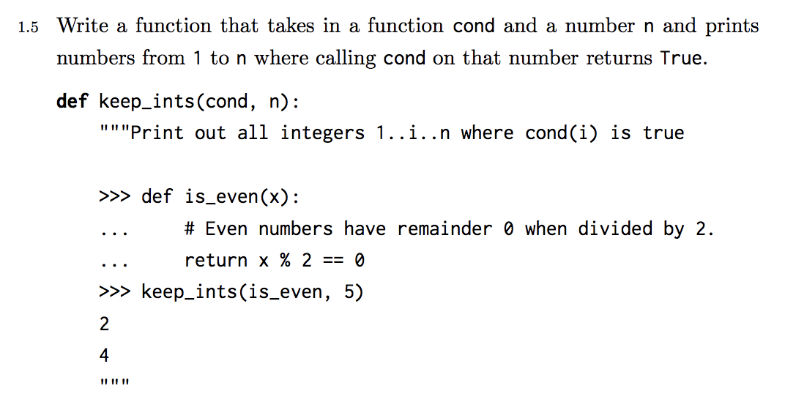
Practice 1.5

Slide 14
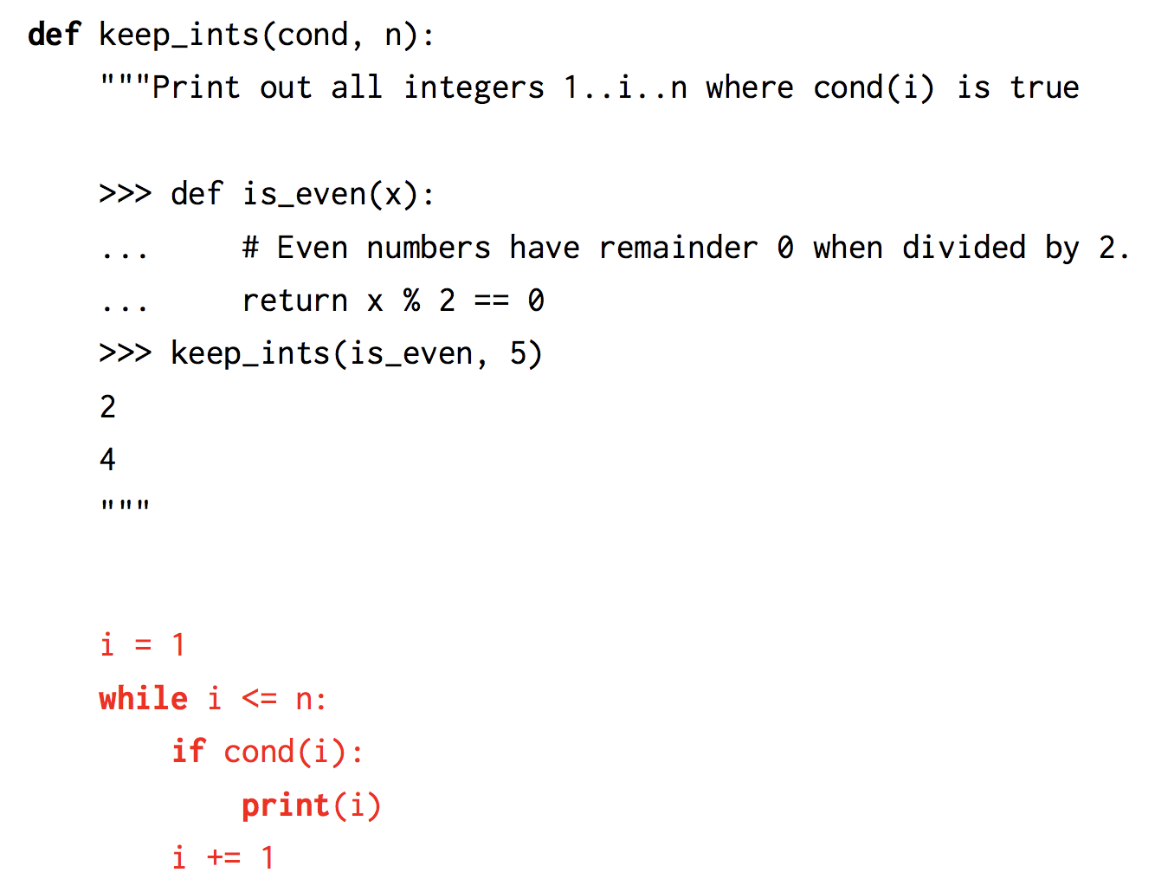
Practice 1.5 Solution

Slide 15
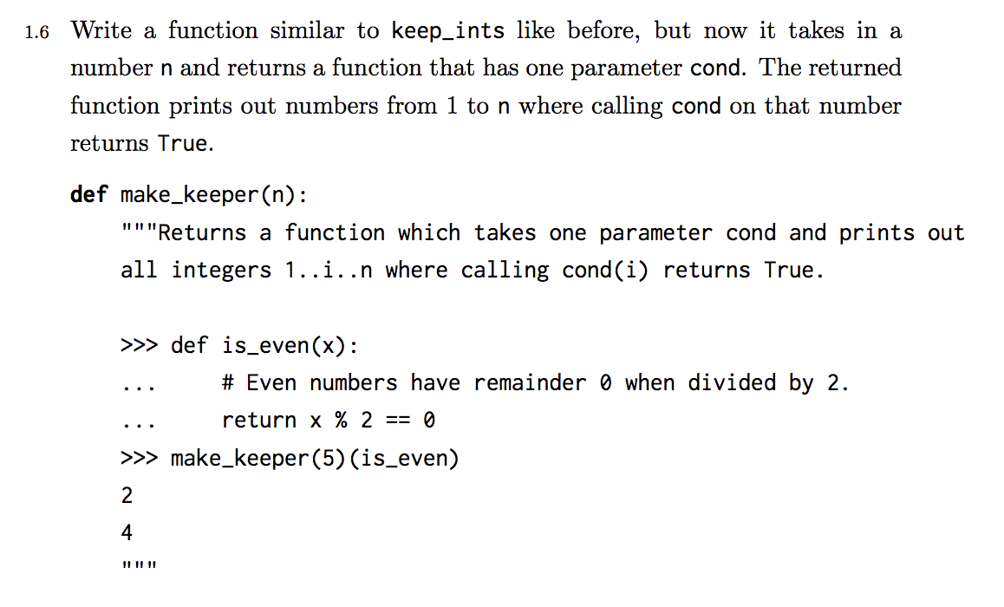
Practice 1.6

Slide 16
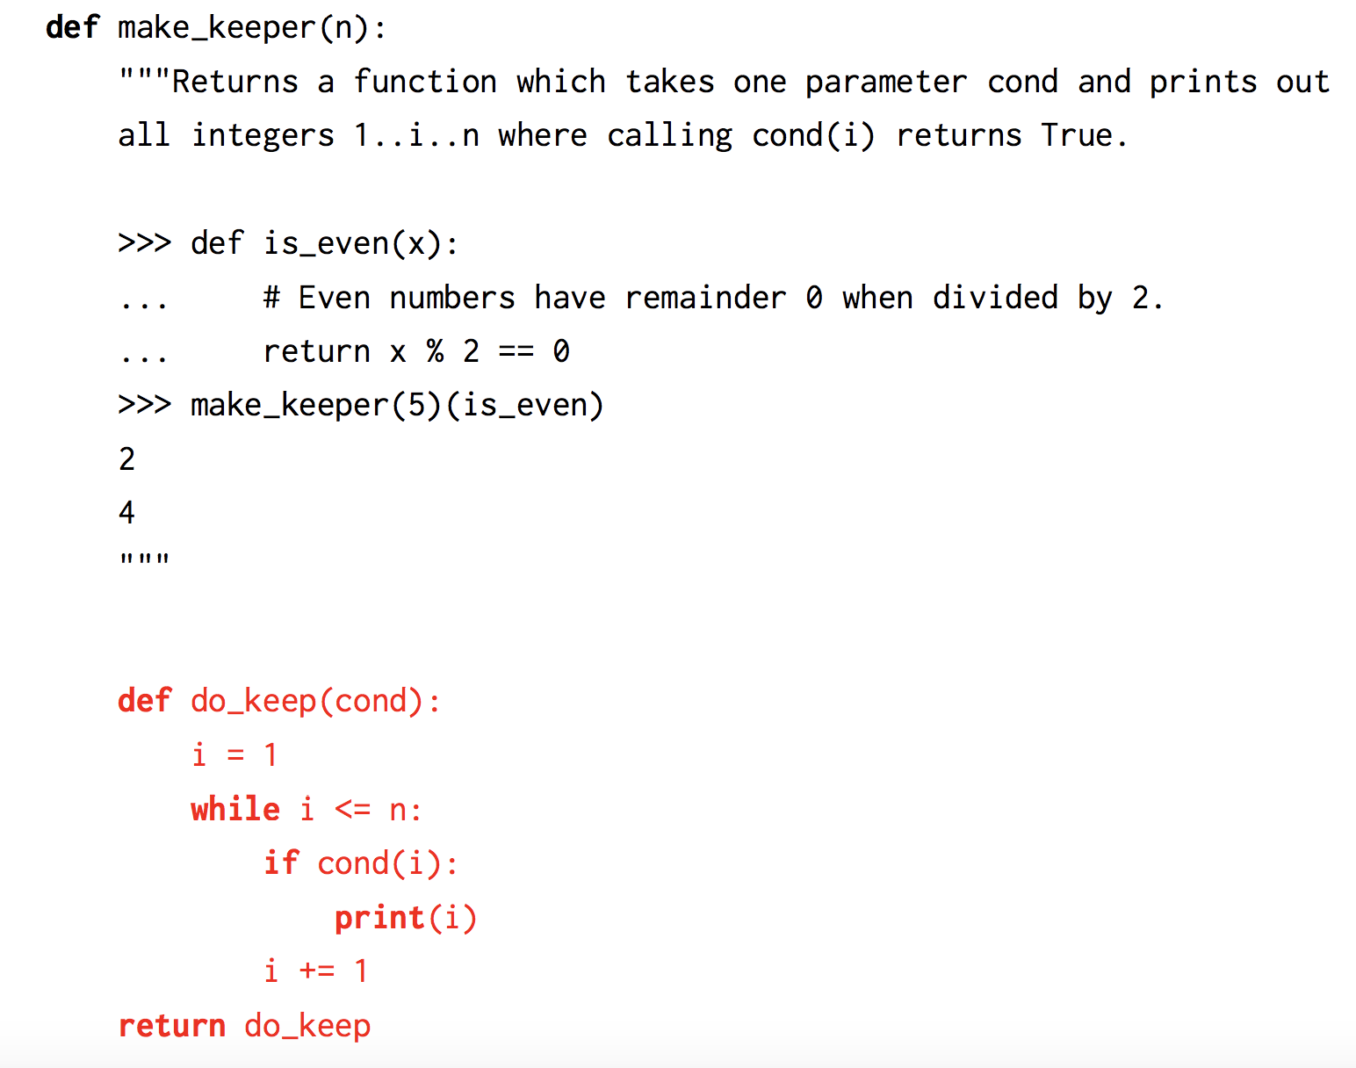
Practice 1.6 Solution

Slide 17
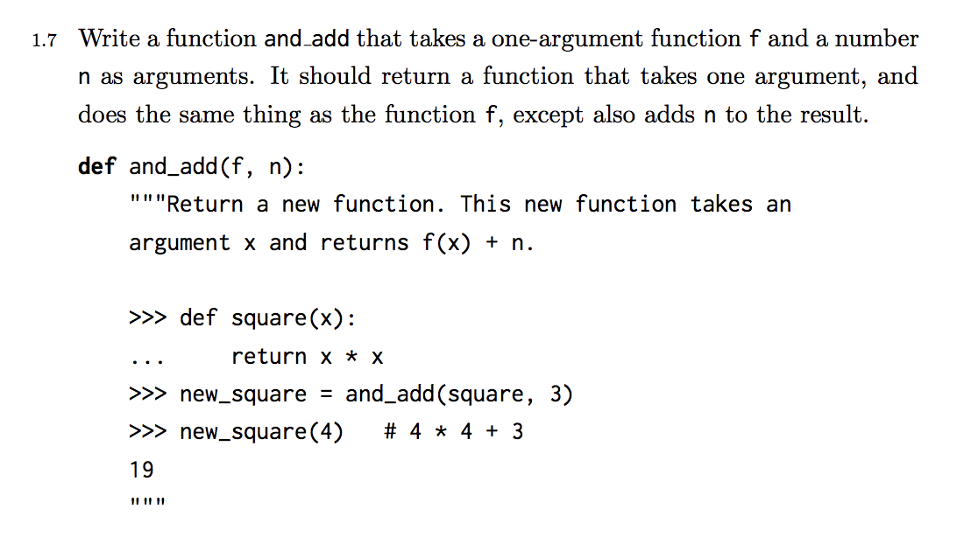
Practice 1.7

Slide 18
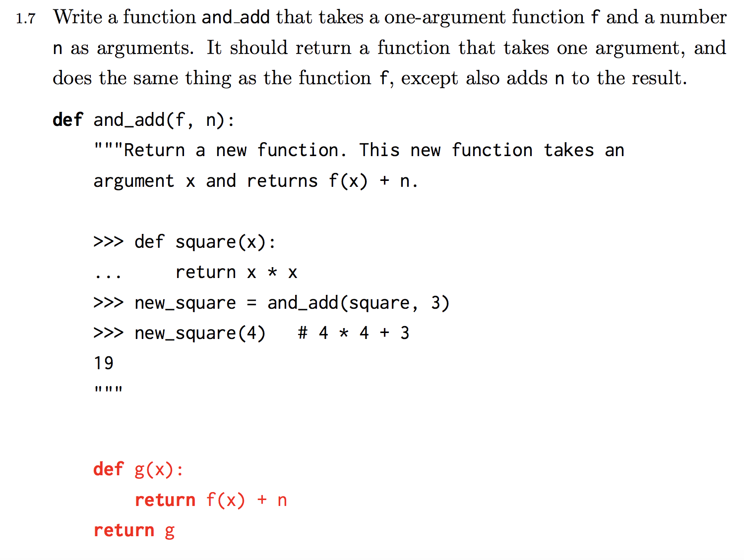
Practice 1.7 Solution

Slide 19
2
Lambdas

Slide 20
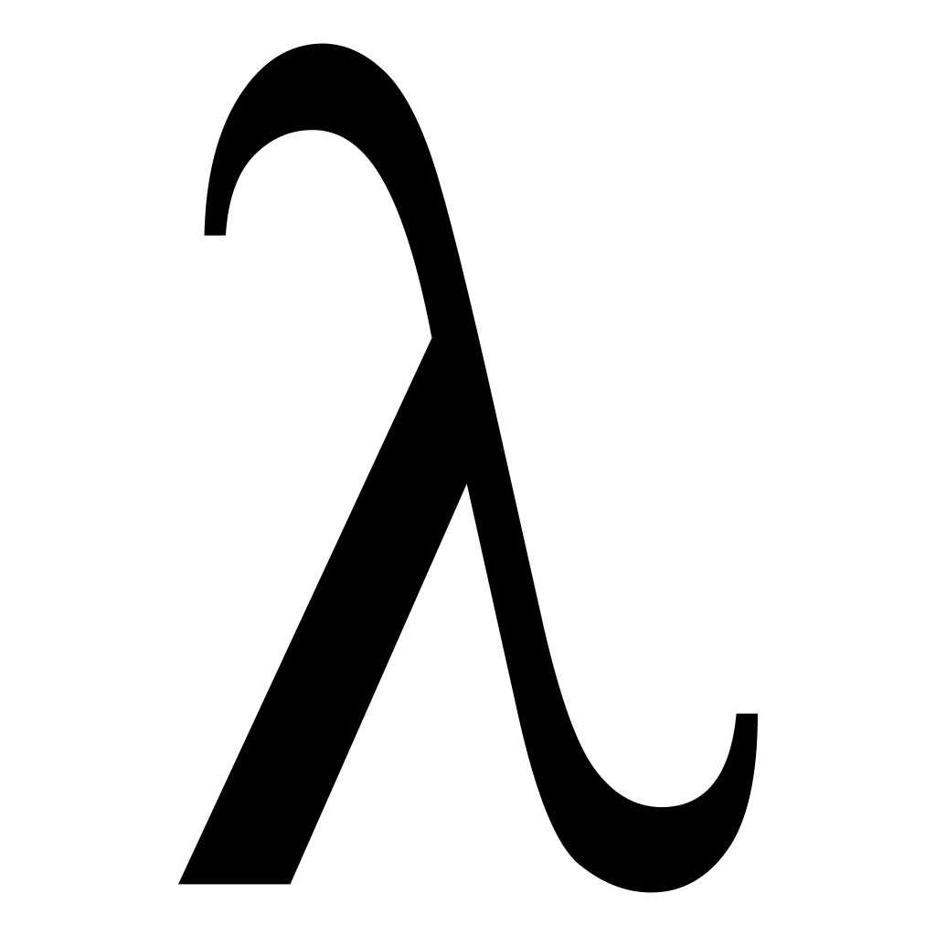
Lambdas
lambda <parameters>: <return expression>

Slide 21
Lambdas
lambda <parameters>: <return expression>
represents a function on-the-fly without using an intrinsic name (does not have a name; uses the lambda symbol ƛ instead)

Slide 22
Lambdas
lambda <parameters>: <return expression>
represents a function on-the-fly without using an intrinsic name (does not have a name; uses the lambda symbol ƛ instead) by including the following:
Formal parameters
Return value

Slide 23
Lambdas
lambda <parameters>: <return expression>
represents a function on-the-fly without using an intrinsic name (does not have a name; uses the lambda symbol ƛ instead) by including the following:
Formal parameters
Return value
Like normally defined functions, the parent of a lambda function is still the frame in which the function was defined!

Slide 24
Lambda Expression
lambda a, b: a * b

Slide 25
Lambda Expression
lambda a, b: a * b
Takes in 2 formal parameters a, b

Slide 26
Lambda Expression
lambda a, b: a * b
When function is called with specific arguments, the body is evaluated and returns the product a * b

Slide 27
Lambda Expression
> (lambda a, b: a * b)(2, 3)
Make a call with specific parameters passed in!

Slide 28
Evaluating Call Expressions
Evaluate the operator.

Slide 29
Evaluating Call Expressions
Evaluate the operator.
Evaluate the operands.

Slide 30
Evaluating Call Expressions
Evaluate the operator.
Evaluate the operands.
Apply the operator on the operands.

Slide 31
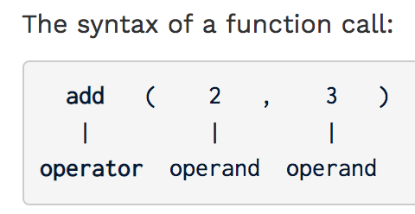
Evaluating Call Expressions
Evaluate the operator.
Evaluate the operands.
Apply the operator on the operands.

Slide 32
Evaluating Call Expressions
Evaluate the operator.
Evaluate the operands.
Apply the operator on the operands.
Evaluates add function.

Slide 33
Evaluating Call Expressions
Evaluate the operator.
Evaluate the operands.
Apply the operator on the operands.
Evaluates add function.
Evaluates the operands 2 and 3.

Slide 34
Evaluating Call Expressions
Evaluate the operator.
Evaluate the operands.
Apply the operator on the operands.
Evaluates add function.
Evaluates the operands 2 and 3.
Make the call
add(2, 3) to get 5.

Slide 35
Lambda Expression
> (lambda a, b: a * b)(2, 3)
Evaluate the operator.

Slide 36
Lambda Expression
> (lambda a, b: a * b)(2, 3)
Evaluate the operands.

Slide 37
Lambda Expression
> (lambda a, b: a * b)(2, 3)
Apply the operator on the operands; i.e. execute the body of the lambda and compute 2 * 3.

Slide 38
Lambda Expression
> (lambda a, b: a * b)(2, 3)
6

Slide 39
Practice 1.2

Slide 40
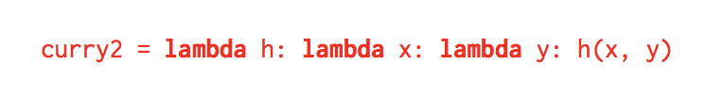
Practice 1.2 Solution

Slide 41
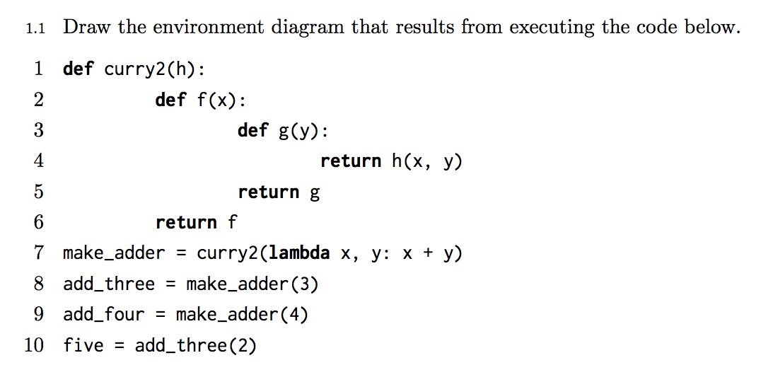
Practice 1.1

Slide 42
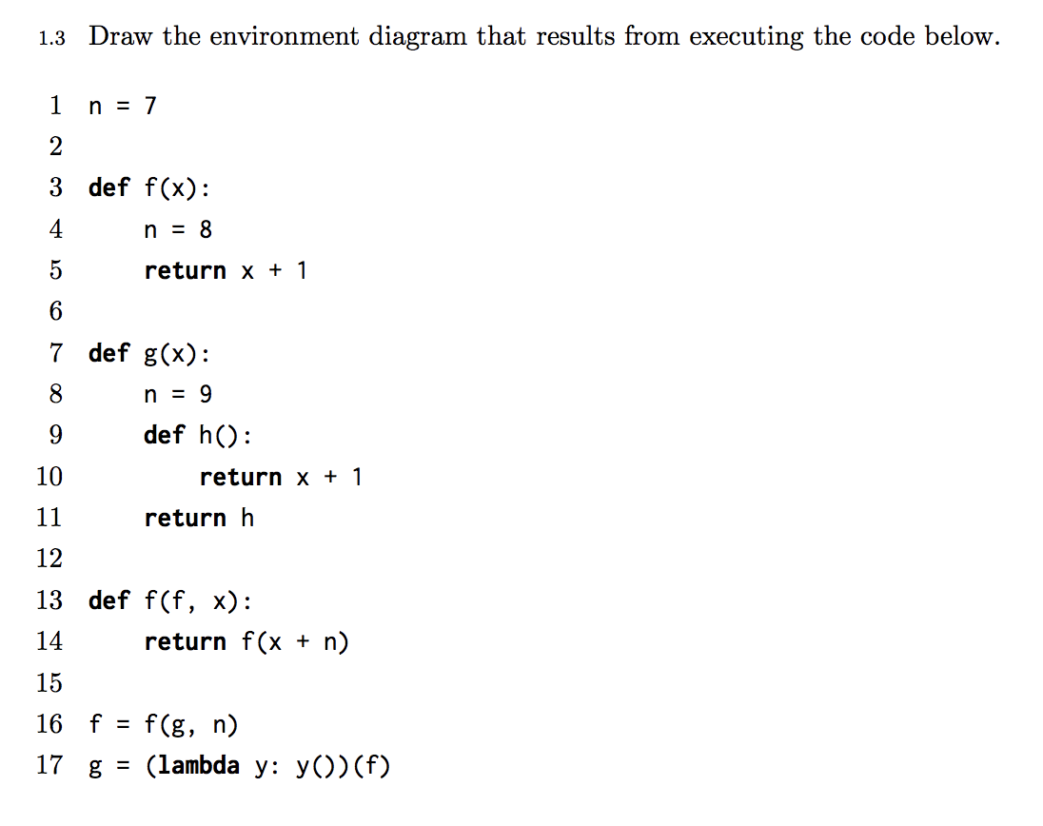
Practice 1.3

